Slide 1

How to take a hint: A case study in linking it all together
http://compcogscisydney.org/psyc2071/
Danielle Navarro

Slide 2

A partial list of important topics
attention
sensation
similarity
perception
reasoning
learning
social cognition
decision making

Slide 3


attention
sensation
similarity
perception
reasoning
learning
social cognition
decision making

Slide 4

attention
sensation
similarity
perception
reasoning
learning
social cognition
decision making

Slide 5
From topics to tasks…
attention
sensation
similarity
Wason selection task
perception
Property induction
reasoning
Argument evaluation
Etc…
learning
social cognition
decision making

Slide 6
Today we’ll reverse this
attention
sensation
similarity
Wason selection task
perception
Property induction
reasoning
Argument evaluation
Etc…
learning
social cognition
decision making

Slide 7
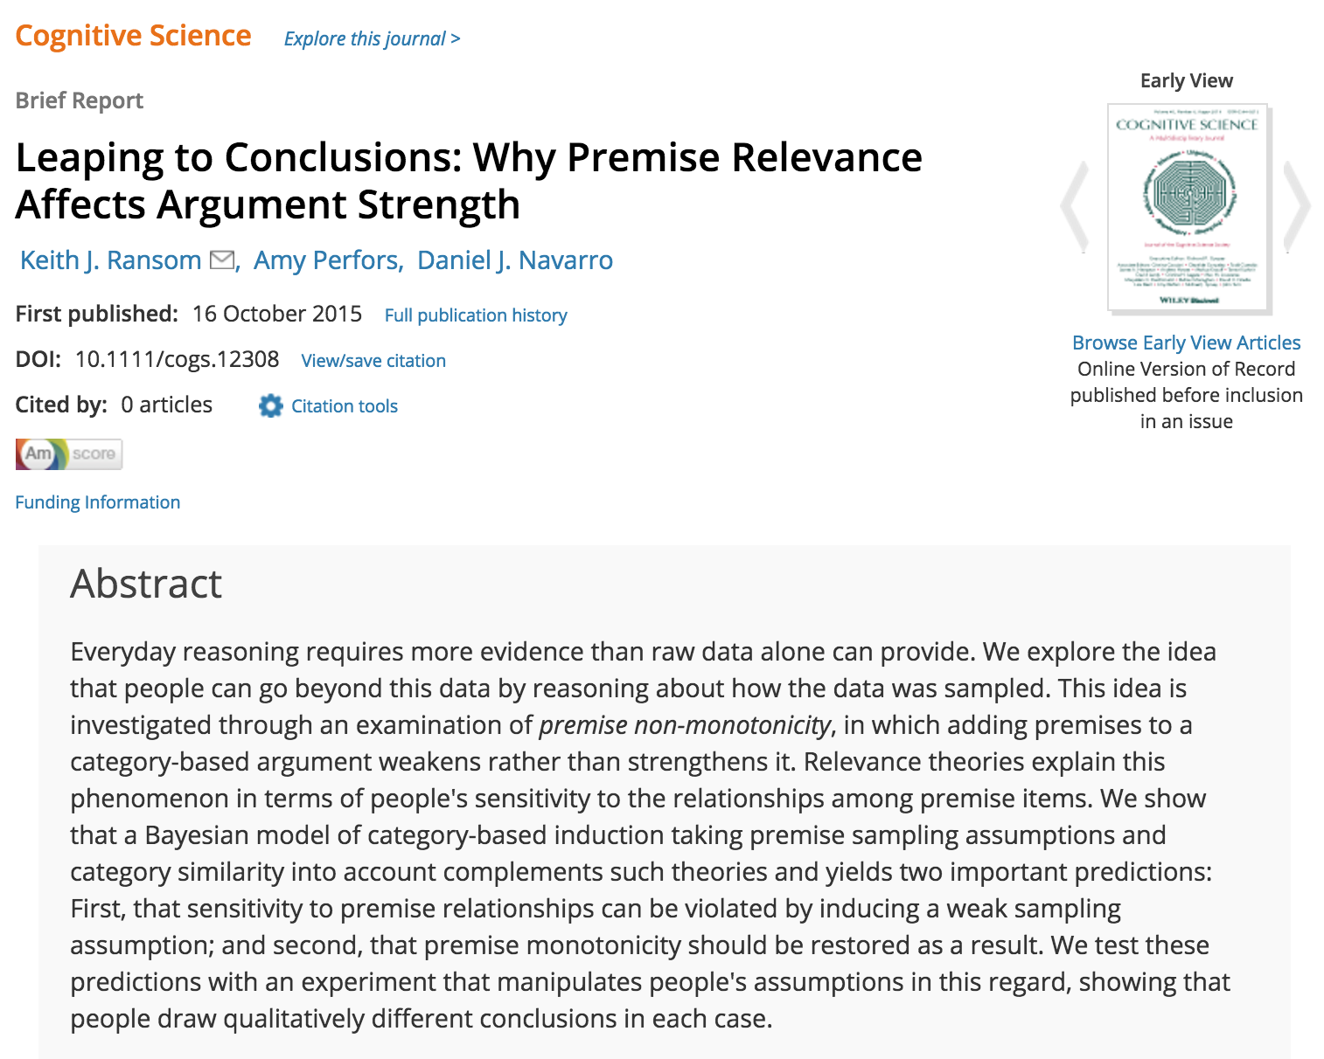
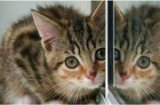


The case study…

Slide 8
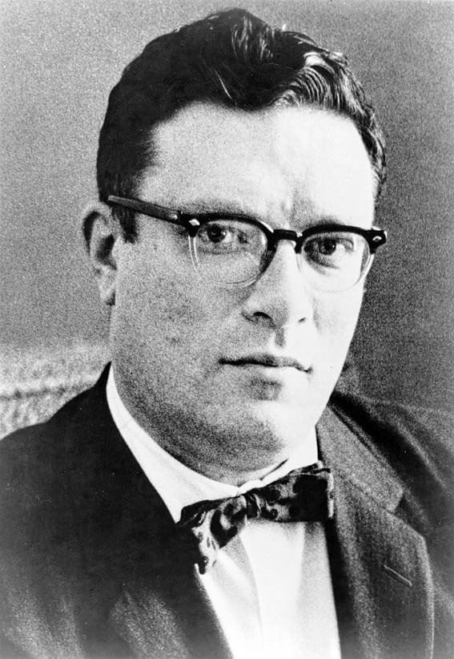
The most exciting phrase to hear in science, the one that heralds new discoveries, is not 'Eureka!' but 'That's funny...' - Isaac Asimov

Slide 9

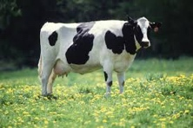
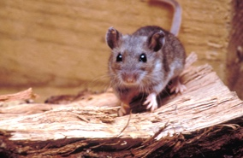
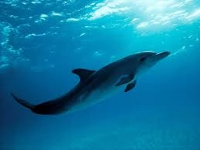
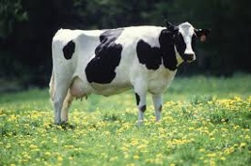
Premise monotonicity
Dolphin cells contain TH4 hormone
Therefore cow cells contain TH4 hormone?
Dolphin cells contain TH4 hormone
Mouse cells contain TH4 hormone
Bat cells contain TH4 hormone
Therefore cow cells contain TH4 hormone?
Adding evidence usually strengthens an inductive argument

Slide 10
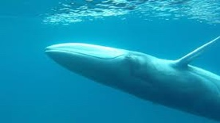
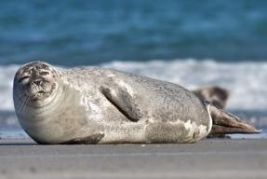

Premise non-monotonicity
Dolphin cells contain TH4 hormone
Therefore cow cells contain TH4 hormone?
Dolphin cells contain TH4 hormone
Whale cells contain TH4 hormone
Seal cells contain TH4 hormone
Therefore cow cells contain TH4 hormone?
Sometimes adding evidence weakens an argument?
“that’s funny?”

Slide 11
But whyyyyyy?
A tale of similarity, attention and social cognition

Slide 12

Observation #1: Similarity shapes reasoning
attention
similarity
reasoning
social cognition

Slide 13
Similarity is relevant to reasoning
Dolphins and cows are dissimilar.
So this feels unreasonable

Slide 14

Similarity is relevant to reasoning
Bats and mice are very to dissimilar cows too, but they’re also dissimilar to dolphins.
Suggests the TH4 hormone is common?
… so the argument gets stronger

Slide 15

Similarity is relevant to reasoning
Seals and whales are very dissimilar to cows too, but they are very similar to dolphins and to each other.
Suggests that TH4 is possessed by a narrow range of animals that does not include cows.
... so the argument gets weaker

Slide 16
Similarity is relevant to reasoning
If the conclusion item (dugong) is “sufficiently similar” to the premise items then monotonicity is restored
… this is also a strong argument

Slide 17
Observation #2: Similarity directs attention* to a particular category
attention
similarity
reasoning
social cognition
*internal attention!

Slide 18
… marine mammals?
Many possible categories that could indicate which animals have TH4 and which don’t
... intelligent animals?
... mammals?
... cute?
Dolphins are …

Slide 19

Adding bats and mice calls attention to mammal
… marine mammals?
... intelligent animals?
... mammals?
... cute?

Slide 20

Adding whales and seals calls attention to marine mammal
… marine mammals?
... intelligent animals?
... mammals?
... cute?

Slide 21
… marine mammals?
Notice: seals and whales are also intelligent cute mammals. These possibilities aren’t ruled out, we just ignore them
... intelligent animals?
... mammals?
... cute?

Slide 22
A scientific question… Why does this similarity-driven attention influence our reasoning?
attention
similarity
reasoning
social cognition

Slide 23



On the origins of data
Information from the world
Information from people

Slide 24
Humans are intelligent agents with complex goals and a rich language. We “transmit” information to each other via a complicated mechanism... persuasion

Slide 25
How does this communication work?
If I choose these similar animals…

Slide 26
… then you will notice the similarity, driving your attention to “marine mammals”

Slide 27



I know that your mind works like this

Slide 28



And you know that I know. You know I wanted you to think of a particular category … so you can “take a hint”

Slide 29
Theory of mind!
We have intuitive theories about the workings of each other’s minds, so we can select relevant information that drives attention to the right answer

Slide 30
So humans do this…
“I’ve studied TH4 hormone for many years… and I have discovered it in the cells of whales, seals and dolphins.
I want you to believe that dugongs will produce TH4 hormone”

Slide 31
And we do this…
“I’ve studied TH4 hormone for many years… and I have discovered it in the cells of mice, bats and dolphins.
I want you to believe that cows will produce TH4 hormone”

Slide 32
We don’t do this:
“I’ve studied TH4 hormone for many years… and I have discovered it in the cells of whales, seals and dolphins.
I want you to believe that kittens will produce TH4 hormone”

Slide 33
Okay, so how does this other mechanism work?

Slide 34
The world is dumb. It does not care what you believe. It does not give “hints”
You know that it does not care what you believe. You do not expect the world to behave like an intelligent or helpful agent.

Slide 35

The world generates data randomly
My cat’s breath smells like cat food
Unicorns are awesome
Dolphins are cute

Slide 36

The world generates data randomly
My cat’s breath smells like cat food
Unicorns are awesome
Dolphins are cute
??????

Slide 37
The world doesn’t care what you believe, and it doesn’t try to influence you: it’s just a big dumb rock
Other humans do care what you believe, and they do try to shape your beliefs by choosing the right words
Data are random
Data are relevant

Slide 38
Do I reason differently in these two situations?
(& can this explain non-monotonic reasoning?)
(& if so, is that the right thing to do?)
Data are random
Data are relevant

Slide 39
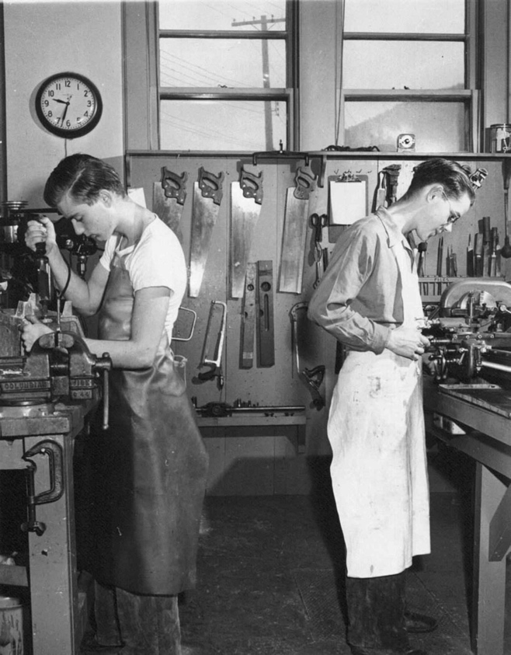
To the laboratory!

Slide 40
The reasoning task
Item A has property P
Item X has property P
How likely is it that item X has property P?
0%
25%
50%
75%
100%
Participants are first asked to rate an inductive argument with a single premise

Slide 41
The reasoning task
Item A has property P
Item B has property P
Item X has property P
How likely is it that item X has property P?
0%
25%
50%
75%
100%
A second item is added and they are asked to revise their estimate

Slide 42

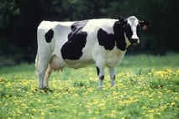

Argument 1b
Item A has property P
Item B has property P
Item X has property P
Argument 1a
Item A has property P
Item X has property P

Slide 43
DV is the difference score
Argument 1b
>0 : premise monotonicity
Item A has property P
Item B has property P
Item X has property P
Response b minus response a
0 : no change
Argument 1a
Item A has property P
Item X has property P
<0 : premise non- monotonicity

Slide 44

Our hypothesis
When an indifferent world generates random data, the similarity between premise items will be deemed irrelevant, and people will revert to premise monotonicity
When a helpful human makes an argument, the similarity between premise items will be deemed relevant, and the premise non-monotonicity effect will appear

Slide 45
Manipulated variable
Participant believes data are random
>0 : premise monotonicity
DV
0 : no change
Participant believes data are relevant
<0 : premise non- monotonicity

Slide 46
Okay… but how do we manipulate people’s beliefs???

Slide 47
Problem: an experiment is designed by an experimenter....
?
?
It’s going to be hard to convince people that anything in a psychology experiment is truly random!

Slide 48

“Cover story” manipulation
(independent variable #1)
What do we tell people about the origin of the second premise?
Relevant story: It is a hint from a previous participant
Neutral story: Don’t tell them where it comes from
Random story: It is chosen at random from a database

Slide 49
“Experience” manipulation
(independent variable #2)
What do we show people about the nature of the second premise?
Relevant data: Previous examples have been helpful
Random data: Previous examples have been stupid

Slide 50
“Flow” of the experiment
Cover story manipulation appears here:
Arg 1a
The “a” arguments have one premise; when the second premise is added to create the “b” argument, we “remind” the participants that the data [is a hint / ??? / is random ]
Arg 1b

Slide 51
Arg 1a
Arg 2a
Arg 3a
Arg 4a
Arg 5a
Arg 6a
Arg 1b
Arg 2b
Arg 3b
Arg 4b
Arg 5b
Arg 6b
Each participant is shown 6 of these argument pairs

Slide 52
Arg 1a
Arg 2a
Arg 3a
Arg 4a
Arg 5a
Arg 6a
Arg 1b
Arg 2b
Arg 3b
Arg 4b
Arg 5b
Arg 6b
“Filler”
“Filler”
“Filler”
The experience manipulation appears here: the 1st, 2nd and 4th arguments were “filler” items designed to highlight the [relevance / randomness] of the second premise

Slide 53
The “experience” manipulation
A “filler” trial with a relevant second premise:
A “filler” trial with a random second premise:
Arg 1a
Arg 1b
“Filler”

Slide 54
The “experience” manipulation
A “filler” trial with a relevant second premise:
A “filler” trial with a random second premise:
Eagles have multiple foveas
Arg 1a
Doves have multiple foveas
Arg 1b
Eagles have multiple foveas
Hawks have multiple foveas
Doves have multiple foveas
“Filler”

Slide 55

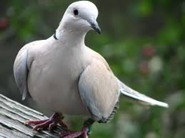
The “experience” manipulation
A “filler” trial with a relevant second premise:
A “filler” trial with a random second premise:
Eagles have multiple foveas
Arg 1a
Doves have multiple foveas
Arg 1b
Eagles have multiple foveas
Hawks have multiple foveas
Doves have multiple foveas
“Filler”
This suggests the involvement of a helpful human because hawks seem relevant to the context

Slide 56
The “experience” manipulation
A “filler” trial with a relevant second premise:
A “filler” trial with a random second premise:
Eagles have multiple foveas
Arg 1a
Doves have multiple foveas
Arg 1b
Eagles have multiple foveas
Tortoises do not have multiple foveas
Doves have multiple foveas
“Filler”

Slide 57
The “experience” manipulation
A “filler” trial with a relevant second premise:
A “filler” trial with a random second premise:
Eagles have multiple foveas
Arg 1a
Doves have multiple foveas
Arg 1b
Eagles have multiple foveas
Tortoises do not have multiple foveas
Doves have multiple foveas
“Filler”
This is the worst hint ever. Why would anyone think tortoises are relevant? Clearly, the second premise is randomly chosen

Slide 58
Incomplete 2x3 design
Experience
Relevant story, Relevant items
Neutral story, Relevant items | Neutral story, Random items
 | Random story, Random items
Story

Slide 59
Incomplete 2x3 design
Experience
Relevant story, Relevant items
Neutral story, Relevant items | Neutral story, Random items
 | Random story, Random items
Story
Q1: Why not 3x3? Where are the “neutral items” conditions?
Q2: Why is it incomplete? Why did we leave two empty cells here?

Slide 60
Now, how should we measure the effect?

Slide 61
Arg 1a
Arg 2a
Arg 3a
Arg 4a
Arg 5a
Arg 6a
Arg 1b
Arg 2b
Arg 3b
Arg 4b
Arg 5b
Arg 6b
“Filler”
“Filler”
“Filler”
We used these three arguments for the IV

Slide 62
Arg 1a
Arg 2a
Arg 3a
Arg 4a
Arg 5a
Arg 6a
Arg 1b
Arg 2b
Arg 3b
Arg 4b
Arg 5b
Arg 6b
“Target”
“Target”
“Control”
We used these three argument for the DV

Slide 63
For target items the second premise was similar to the first premise item but not the conclusion
Grizzly bears produce TH-L2
Arg 5a
Lions produce TH-L2
Arg 5b
Grizzly bears produce TH-L2
Black bears produce TH-L2
Lions produce TH-L2
“Target”

Slide 64
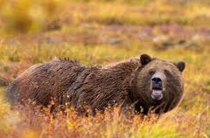
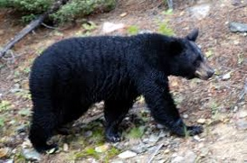
For target items the second premise was similar to the first premise item but not the conclusion
Grizzly bears produce TH-L2
Arg 5a
Lions produce TH-L2
Arg 5b
Grizzly bears produce TH-L2
Black bears produce TH-L2
Lions produce TH-L2
“Target”

Slide 65
For target items the second premise was similar to the first premise item but not the conclusion
If this similarity is deemed relevant… it strongly suggests TH-L2 is a property of bears so the extra evidence weakens the conclusion... non monotonicity

Slide 66
For target items the second premise was similar to the first premise item but not the conclusion
If this similarity is deemed irrelevant because the data are random … the extra “evidence” is almost useless
So we expect no difference or a weak monotonicity effect because at least there’s some extra evidence that TH-L2 is not rare

Slide 67
For the control item the second premise was similar to the first premise and the conclusion
Orangutans need cystocholamine
Arg 5a
Gorillas need cystocholamine
Arg 5b
Orangutans need cystocholamine
Chimpanzees need cystocholamine
Gorillas need cystocholamine
“Target”

Slide 68
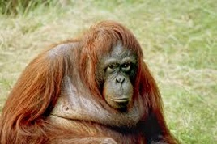
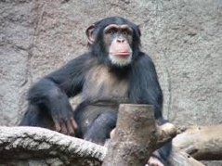
For the control item the second premise was similar to the first premise and the conclusion
Orangutans need cystocholamine
Arg 5a
Gorillas need cystocholamine
Arg 5b
Orangutans need cystocholamine
Chimpanzees need cystocholamine
Gorillas need cystocholamine
“Target”

Slide 69
For the control item the second premise was similar to the first premise and the conclusion
If similarity is considered relevant, it calls attention to “primates”, but this is the intuitively obvious answer anyway. So it really doesn’t make a difference:
... So we expect premise monotonicity in both conditions because either way it reinforces the thing you already believed!
(* This is analogous to the dugongs example earlier)

Slide 70
What we expect to see if our theory is right

Slide 71
Dependent variable is the difference score…
>0 : premise monotonicity
0 : no change
<0 : premise non- monotonicity

Slide 72


Target arguments should show a systematic change when we manipulate the perceived origin of the data…
>0 : premise monotonicity
Random story +
Random experience
Neutral story +
Random experience
Neutral story +
Relevant experience
<0 : premise non- monotonicity
Relevant story +
Relevant experience

Slide 73
Control argument should produce premise monotonicity under all conditions
>0 : premise monotonicity
Relevant story +
Relevant experience
Random story +
Random experience
Neutral story +
Random experience
Neutral story +
Relevant experience
<0 : premise non- monotonicity

Slide 74
What we expect to see if our theory is wrong

Slide 75
If similarity always drives attention and reasoning in the same way, the IVs should make no difference…
>0 : premise monotonicity
<0 : premise non- monotonicity

Slide 76
If similarity always drives attention and reasoning in the same way, the IVs should make no difference…
>0 : premise monotonicity
Control argument is always monotonic
Target arguments are always non-monotonic
<0 : premise non- monotonicity

Slide 77
What we expect to see if our experiment is total garbage

Slide 78
If we made some weird mistake, the data should show no meaningful patterns
>0 : premise monotonicity
<0 : premise non- monotonicity

Slide 79
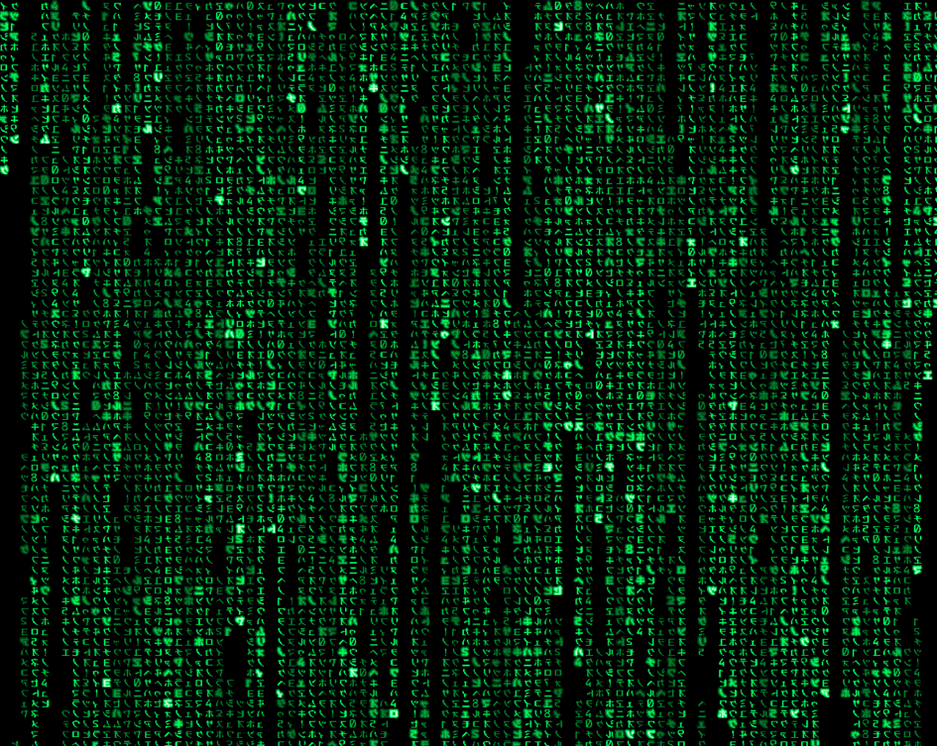
What were our results?

Slide 80
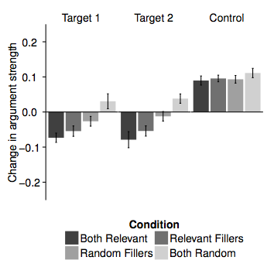
Premise monotonicity
Premise non- monotonicity

Slide 81
Premise monotonicity
Relevant story +
Relevant experience
Random story +
Random experience
Neutral story +
Relevant experience
Neutral story +
Random experience
Premise non- monotonicity
The control argument produces monotonic reasoning in all four conditions

Slide 82
Premise monotonicity
Random story +
Random experience
Neutral story +
Random experience
The target arguments are systematically influenced
Neutral story +
Relevant experience
Premise non- monotonicity
Relevant story +
Relevant experience

Slide 83
Premise monotonicity
Random story +
Random experience
Neutral story +
Random experience
The target arguments are systematically influenced
Neutral story +
Relevant experience
Premise non- monotonicity
Relevant story +
Relevant experience

Slide 84
What does it mean?

Slide 85


We used a psychological theory to help us design an experiment
control
targets
Data are random
Data are relevant
The results agree with our theory and not with competing theories. Yay!

Slide 86
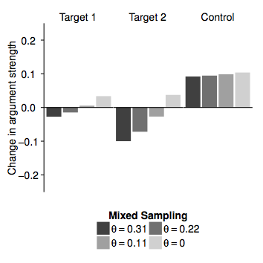
Humans:
Call back to lecture 1… we can get a more precise test using a computational model
control
targets
Data are random
Data are relevant
Model:
control
targets

Slide 87


People are smart (& psychology is hard)
Sometimes inductive reasoning is driven by intuitive theories of the world
Sometimes inductive reasoning is driven by “theory of mind”
We switch flexibly between these in a sensible way – and the inductive power of an argument changes when we do so.

Slide 88
What are the limitations?

Slide 89
Possible limitations?
Sample size too small?
Sample not representative?
Stimulus order not randomised?
Factors not fully crossed?
Limited range of arguments?
Limited range of phenomena?

Slide 90
Probably not. We collected data from 538 participants
Sample size too small?
Sample not representative?
Stimulus order not randomised?
Factors not fully crossed?
Limited range of arguments?
Limited range of phenomena?

Slide 91
Maybe? Our participants were recruited online: diverse in age and gender, but narrow in nationality (USA) and probably above average in education
Important question: is there a plausible reason to think this might matter?
Sample size too small?
Sample not representative?
Stimulus order not randomised?
Factors not fully crossed?
Limited range of arguments?
Limited range of phenomena?

Slide 92
Sample size too small?
Sample not representative?
Stimulus order not randomised?
Factors not fully crossed?
Limited range of arguments?
Limited range of phenomena?
Probably not.
The non random ordering (i.e., fillers mostly first) was intentional, and was central to the experimental manipulation

Slide 93
Sample size too small?
Sample not representative?
Stimulus order not randomised?
Factors not fully crossed?
Limited range of arguments?
Limited range of phenomena?
Absolutely not. It would have been absurd to include a “relevant story + random experience” condition… this would introduce a confound colloquially referred to as “lying to participants”

Slide 94
Sample size too small?
Sample not representative?
Stimulus order not randomised?
Factors not fully crossed?
Limited range of arguments?
Limited range of phenomena?
Definitely a limitation. We used a fixed set of six arguments, all of which were about animals.
Important question: why might this matter? (hint… people have different knowledge)

Slide 95
Sample size too small?
Sample not representative?
Stimulus order not randomised?
Factors not fully crossed?
Limited range of arguments?
Limited range of phenomena?
Definitely a limitation. We only looked at the premise (non) monotonicity effect.
There are good reasons to think the same manipulations should influence other inductive phenomena

Slide 96
Final thoughts?

Slide 97

attention
similarity
induction
reasoning
learning
social cognition
A “single” task often requires psychologists to think about several different aspects of human cognition

Slide 98


attention
similarity
induction
reasoning
learning
social cognition
A “single” task often requires psychologists to think about several different aspects of human cognition
Using psychological theories to guide experimental design yields insight into how cognition works

Slide 99
attention
similarity
induction
reasoning
learning
social cognition
A “single” task often requires psychologists to think about several different aspects of human cognition
Using psychological theories to guide experimental design yields insight into how cognition works
Human reasoning (and cognition generally) can be remarkably complicated

Slide 100
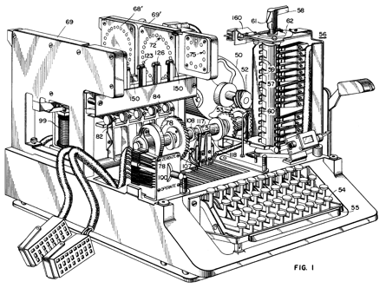
attention
similarity
induction
reasoning
learning
social cognition
A “single” task often requires psychologists to think about several different aspects of human cognition
Using psychological theories to guide experimental design yields insight into how cognition works
Human reasoning (and cognition generally) can be remarkably complicated
… which is one of the reasons we build models

